Slide 1


Introduction to Machine Learning
(21BSAI35E02)
PROJECT TITLE: SIGMA PREDICTION USING AIML
NAME: PUJITA SUNNAPU
ENROLLMENT NO.: 20210701019

Slide 2

AGENDA
Introduction
Dataset Overview
Data Pre-Processing
Correlation Analysis
Machine Learning Models
Linear Regression
Ridge regression
Decision Tree
SVM
Random Forest
Evaluation Metrics
Conclusion

Slide 3

INTRODUCTION
Sigma Prediction using Artificial Intelligence and Machine Learning (AIML) has become a ground-breaking method in the field of process optimisation with significant consequences for organisational effectiveness.
Sigma Prediction is the conductivity of materials derived by experiments on materials.
The project uses artificial intelligence and machine learning (AIML) to analyse process data from the past, find trends, and forecast future Sigma values

Slide 4
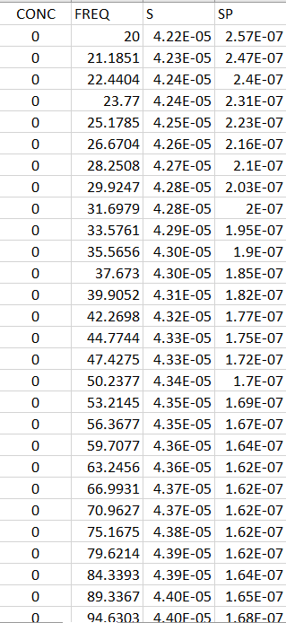

DATASET OVERVIEW
3. CONC (Concentration):
Concentration is a measure of the amount of a substance per unit volume or unit mass of a mixture. It could be measured in various units depending on the context (e.g., moles per liter, grams per liter, etc.). Without additional information, it's not possible to determine the specific substance or unit of concentration used in this dataset.
1. Sigma (σ): Real Part - Conductivity:
The real part of the complex conductivity is denoted by the symbol σ (sigma). It represents the actual conductive behavior of a material in response to an applied electric field. This part is associated with the ohmic (resistive) response of the material.
.
2. Sigma Prime (σ'): Imaginary Part:
The imaginary part of the complex conductivity is denoted by σ' (sigma prime). It is related to the capacitive or dielectric response of a material. This part is associated with the storage of electrical energy in the material
3. FREQ (Frequency):
- The "FREQ" column represents frequency, which is a measure of how often a periodic phenomenon repeats per unit of time. In the context of your dataset, it could be associated with a frequency-dependent measurement, such as electrical conductivity or impedance, particularly if the dataset is related to physics, electronics, or materials science. The values in this column seem to represent different frequencies at which measurements have been taken.

Slide 5
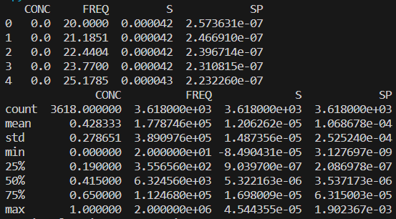
DATA PREPROCESSING
Managing missing values, dealing with outliers, normalizing numerical variables, encoding categorical characteristics, and dividing training and testing data are important processes.
By guaranteeing the integrity of the dataset, providing insights into variable interactions, and readying the data for the efficient application of machine learning models, data preprocessing and analysis are fundamental stages that support the project's overall success
We combined Multiple worksheets and later on created one single worksheet.

Slide 6
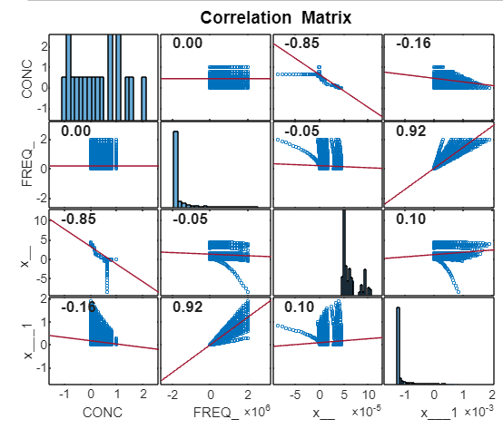
CORRELATION ANALYSIS

Slide 7
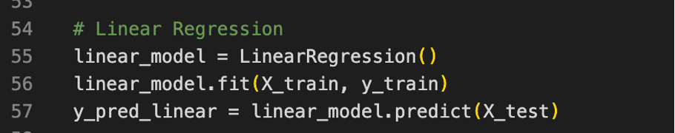

MODEL BUILDING: LINEAR REGRESSION
WHAT?
Linear regression is a statistical method used for modeling the relationship between a dependent variable and one or more independent variables by fitting a linear equation to observed data.
It is used because of its correctness and precision, this model is especially reliable for the provided dataset.
OUTPUT?
Mean Squared Error (MSE): 0.0000
Mean Absolute Error: 0.0000
Root Mean Squared Error (RMSE): 0.0000
R-squared Value: 1.0000

Slide 8
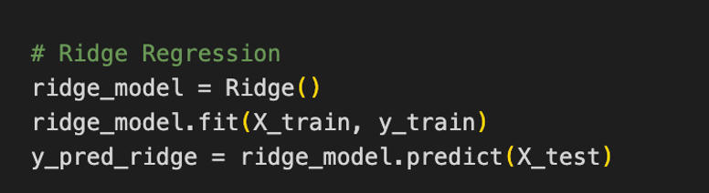
MODEL BUILDING: RIDGE REGRESSION
WHAT?
Ridge Regression is a strong and useful method for the available dataset, exhibiting a high degree of accuracy in its forecasting skills.
OUTPUT?
Mean Squared Error (MSE): 0.0000
Mean Absolute Error: 0.0041
Root Mean Squared Error (RMSE): 0.0061
R-squared Value: 0.9977

Slide 9
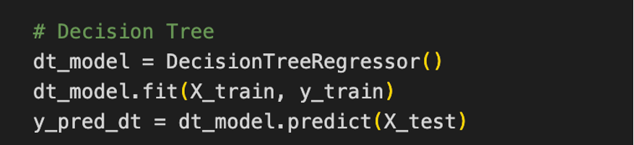
MODEL BUILDING: DECISION TREE
WHAT?
Decision Tree model has excellent prediction accuracy and power, as seen by the high R-squared value, low RMSE, and almost zero MSE.
OUTPUT?
Mean Absolute Error: 0.0019
Mean Squared Error: 0.0000
Root Mean Squared Error: 0.0062
R-squared Value: 0.9976

Slide 10
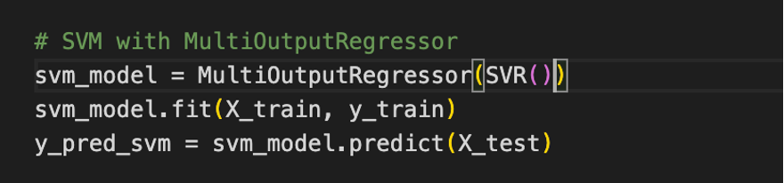
MODEL BUILDING: SUPORT VECTOR MACHINE
WHAT?
The Support Vector Machine (SVM) model's assessment metrics shed light on how well it predicts outcomes.
The MSE, RMSE, and R-squared value all point to a moderate degree of prediction accuracy for the SVM model
OUTPUT?
Mean Absolute Error: 0.0686
Mean Squared Error: 0.0055
Root Mean Squared Error: 0.0737
R-squared Value: 0.6640

Slide 11
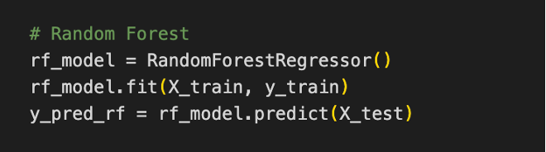
MODEL BUILDING: RANDOM FOREST
RANDOM FOREST
Mean Squared Error (MSE): 0.0000
Mean Absolute Error: 0.0012
Root Mean Squared Error (RMSE): 0.0039
R-squared Value: 0.9989
As the near-zero MSE, low RMSE, and extraordinarily high R-squared value demonstrate, the Random Forest model demonstrates incredible predictive accuracy. All of these indicators suggest that the Random Forest algorithm is a great fit for the dataset
A better match to the data is indicated by models with R-squared values that are closer to 1. In this instance, R-squared values closer to 1 were obtained by Decision Tree, Random Forest, Ridge Regression, and Linear Regression, showing good performance.

Slide 12
MODEL | MEAN SQUARED ERROR | MEAN ABSOLUTE ERROR | RMSE | R-SQUARED VALUES
Linear Regression | 0.0000 | 0.0000 | 0.0000 | 1.0000
Ridge Regression | 0.0000 | 0.0041 | 0.0061 | 0.9977
Decision Tree | 0.0000 | 0.0019 | 0.0066 | 0.9972
SVM | 0.0000 | 0.0019 | 0.0062 | 0.9976
Random Forest | 0.0000 | 0.0012 | 0.0038 | 0.9989
MODEL | MEAN SQUARED ERROR | RMSE | R-SQUARED VALUES
Linear Regression | 0.0000 | 0.0000 | 1.0000
Ridge Regression | 0.0000 | 0.0061 | 0.9977
Decision Tree | 0.0000 | 0.0066 | 0.9972
Random Forest | 0.0000 | 0.0038 | 0.9989

Slide 13
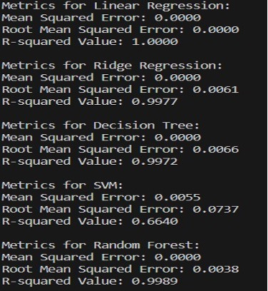
CONCLUSIONS
Each model's performance is methodically analysed to give a clear picture of its advantages and disadvantages in terms of forecasting Sigma levels. Each model's goodness of fit, accuracy, and precision are measured using evaluation metrics. Based on these results we came to our final conclusion.

Slide 14
Thank
you!

